Slide 1
Perceptron for Dummies
2018
Present by:
Liew Jen Wai
Ong Jia Aun
Wong Yu Kang

Slide 2
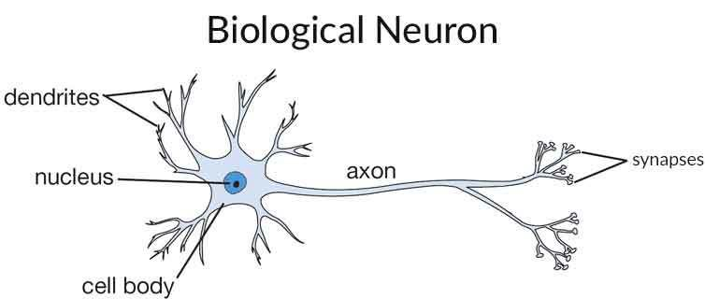
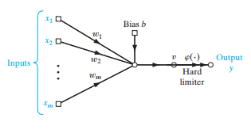
Perceptron
Biological Neuron
Artificial Neuron

Slide 3
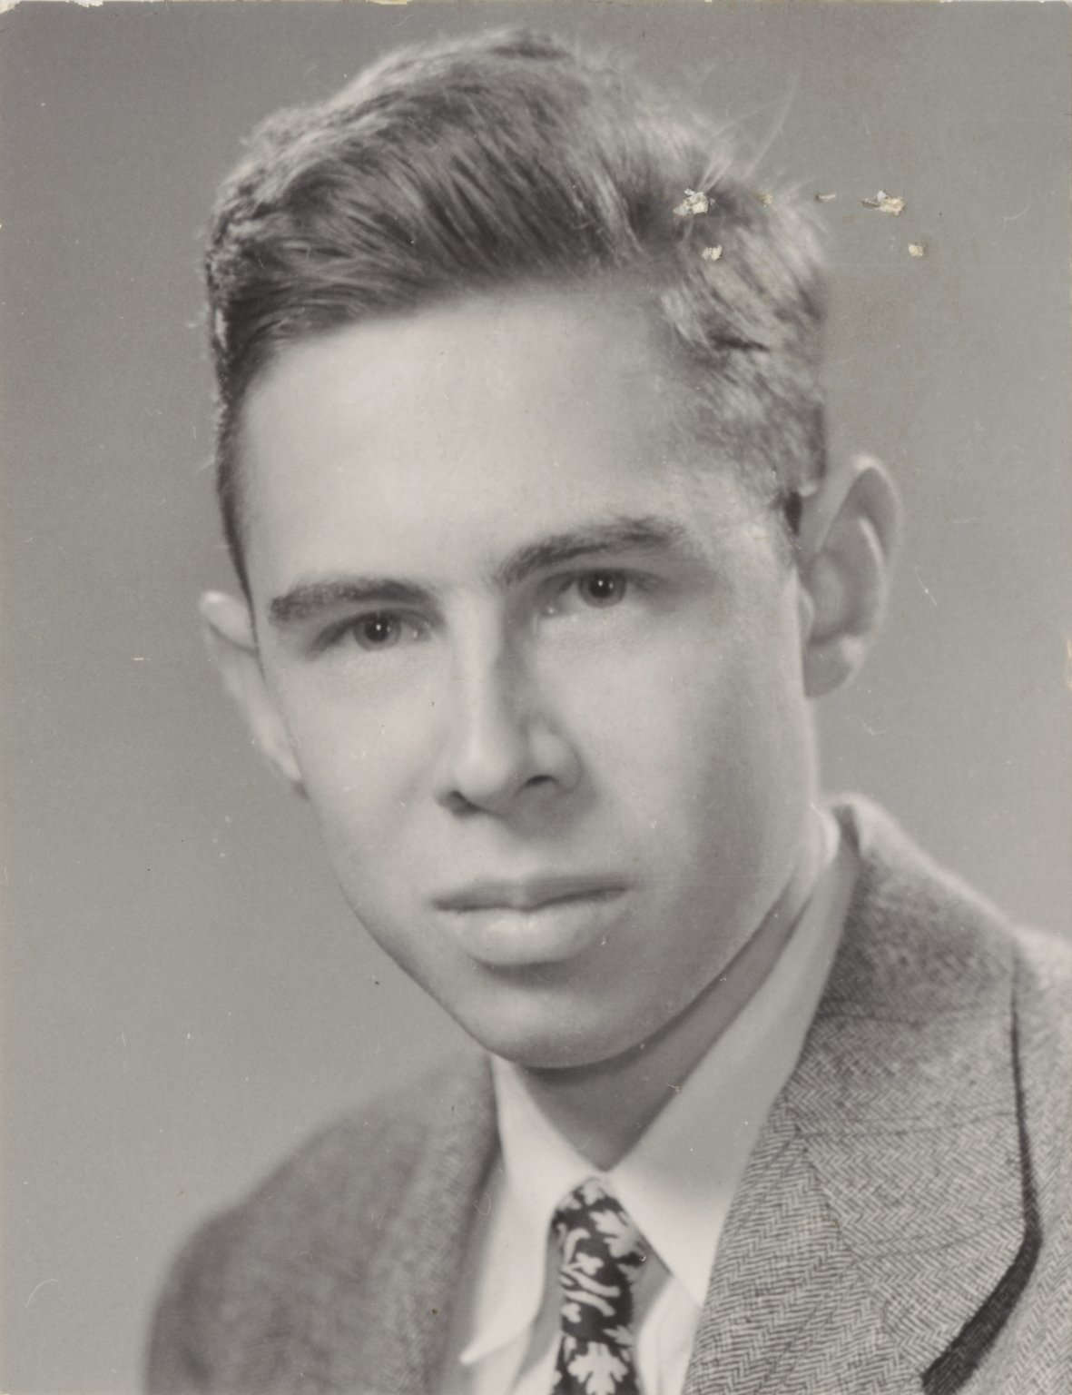
Inventor
Frank Rosenblatt
- American Psychologist
- Researcher at Cornell Aeronautical Laboratory
- create Mark 1 Perceptron

Slide 4
Timeline
Donald Hebb proposed Hebb’s Rule
Creation of
Mark 1 Perceptron
1943
1957
1960
1949
Mc Culloch & Pitts published a paper about idea of Neural Network
Frank Rosenblatt devised perceptron algorithm

Slide 5
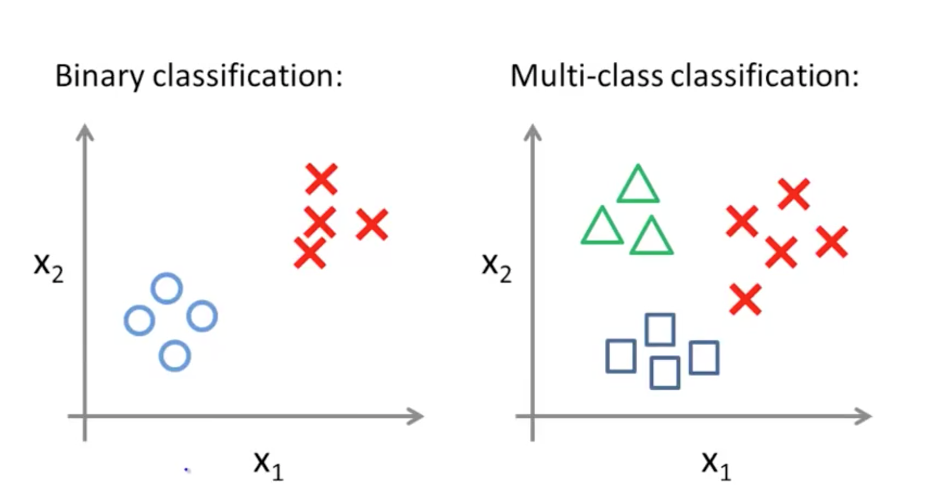
Application
Binary Classification
-classify elements into 2 groups using basic classification rules.

Slide 6
Advantages
Train the machine to do Binary Classification and decreasing the error by adjusting the weight and bias.

Slide 7
References
https://www.pearsonhighered.com/assets/samplechapter/0/1/3/1/0131471392.pdf
https://en.wikipedia.org/wiki/Perceptron
http://web.mit.edu/mcraegroup/wwwfiles/ChuangChuang/thesis_files/Appendix%20D_Artificial%20Neural%20Network.pdf

Slide 8
Methodology
PBL Learning Experience

Slide 9
Step 1: Explore the Issues
Step 2: Gather Knowledge
Step 3: Develop & Write Problem Statement

Slide 10
Step 4: List out Possible solutions
Step 5: List out Actions to be taken
Step 6: List out What do we need to know
Step 7: Documentation

Slide 11
The End.
Thank you…

